Slide 1

CANNABIS CONTROL COMMISSION
Public Meeting
April 9, 2020
10:00AM
Cannabis Control Commission
Via Remote Participation
All meeting materials available at masscannabiscontrol.com/documents

Slide 2
Agenda
Call to Order
Chairman’s Comments & Updates
Minutes for Approval
Staff Recommendations on Changes of Ownership
Staff Recommendations on Changes of Location
Staff Recommendations on Renewals
Staff Recommendations on Final Licenses
Staff Recommendations on Provisional Licenses
Commission Discussion and Votes
  Delegation of Authority: Applications for Energy Extensions
  Update; Best Management Practices for Water Usage
New Business that the Chairman did not anticipate at time of posting
Next Meeting Date
Adjournment
All meeting materials available at masscannabiscontrol.com/documents

Slide 3
4) Staff Recommendations on Changes of Ownership
  Canna Provisions, Inc.
  Cultivate Holdings, LLC
  Theory Farms, LLC
All meeting materials available at masscannabiscontrol.com/documents

Slide 4
5) Staff Recommendations on Changes of Location
  Nature’s Remedy of Massachusetts, Inc. (#MRN282049), Retail
All meeting materials available at masscannabiscontrol.com/documents

Slide 5
6) Staff Recommendations on Renewals
a. Theory Wellness, Inc. (#MCR139866)
b. Greener Leaf, Inc. (#MRR205568)
c. Nature’s Remedy of Massachusetts, Inc. (#MCR139865)
d. Nature’s Remedy of Massachusetts, Inc. (#MPR243511)
e. Nature’s Remedy of Massachusetts, Inc. (#MRR205564)
f. Nature’s Remedy of Massachusetts, Inc. (#MRR205570)
g. Atlantic Medicinal Partners, Inc. (#MRR205569)
h. Nova Farms, LLC (#MCR139868)
i. Beacon Compassion, Inc. (#MCR139871)
j. Beacon Compassion, Inc. (#MPR243516)
k. Silver Therapeutics, Inc. (#MRR205573)
l. Berkshire Roots, Inc., (#RMD505)
m. Green Meadows Farms, LLC, Vertically Integrated Medical Marijuana Treatment Center
All meeting materials available at masscannabiscontrol.com/documents

Slide 6
6) Staff Recommendations on Renewals
n. Just Healthy, LLC, Vertically Integrated Medical Marijuana Treatment Center
o. Holistic Industries, Vertically Integrated Medical Marijuana Treatment Center
p. Theory Wellness, Inc., (#RMD305)
q. Alternative Compassion Services, Inc., (#RMD585)
r. Patriot Care Corp., (#RMD165)
s. Beacon Compassion Center, Inc., Vertically Integrated Medical Marijuana Treatment Center
t. Curaleaf Massachusetts, Inc., (#RMD765)
u. Green Gold Group, Inc., (#RMD786)
v. Mass Alternative Care, Inc, Vertically Integrated Medical Marijuana Treatment Center
w. Phytotherapy, Inc., Vertically Integrated Medical Marijuana Treatment Center
x. Emerald Grove, Inc, Vertically Integrated Medical Marijuana Treatment Center
y. Central Avenue Compassionate Care, Inc (#RMD145)
All meeting materials available at masscannabiscontrol.com/documents

Slide 7
7) Staff Recommendations on Final Licenses
a. Apothca Inc. (#MC281276), Cultivation, Tier 5 / Indoor
b. Apothca Inc. (#MP281455), Product Manufacturer
c. Boston Bud Factory Inc (#MR281525), Retail
d. Canna Provisions, Inc. (#MR281778), Retail
e. Cannabis Connection, Inc. (#MR281362), Retail
f. Cultivate Holdings, LLC (#MR282522), Retail
g. Eagle Eyes Transport, Inc. (#MT281320), Third-Party Transporter
h. Haverhill Stem, LLC (#MR281327), Retail
i. HVV Massachusetts, Inc. (#MC282121), Cultivation, Tier 3 / Indoor
j. HVV Massachusetts, Inc. (#MP281657), Product Manufacturer
k. HVV Massachusetts, Inc. (#MR282578), Retail
l. Old Planters of Cape Ann, Inc. (#MR282588), Retail
m. TDMA, LLC (#MR282376), Retail
All meeting materials available at masscannabiscontrol.com/documents

Slide 8
7) Staff Recommendations on Final Licenses
n. Temescal Wellness of Massachusetts, LLC (#MR282033), Retail
o. The Heirloom Collective, Inc. (#MC281438), Cultivation, Tier 2 / Indoor
p. The Heirloom Collective, Inc. (#MP281407), Product Manufacturer
All meeting materials available at masscannabiscontrol.com/documents

Slide 9
8) Staff Recommendations on Provisional Licenses
  a. ARL Healthcare, Inc. (#MCN281622), Cultivation, Tier 4 / Indoor
  b. ARL Healthcare, Inc. (#MPN281681), Product Manufacturer
  c. ARL Healthcare, Inc. (#MRN282382), Retail
  d. Berkley Botanicals, LLC (#MCN282081), Cultivation, Tier 2 / Indoor
  e. Berkley Botanicals, LLC (#MPN281642), Product Manufacturer
  f. Berkley Botanicals, LLC (#MRN281458), Retailer
  g. BWell Holdings, Inc. (#MRN282825), Retail
  h. CNA Stores, Inc. (#MCN282190), Cultivation, Tier 4 / Indoor
  i. CNA Stores, Inc. (#MPN281691), Product Manufacturer
  j. CNA Stores, Inc. (#MRN281744), Retail
  k. CNA Stores, Inc. (#MRN282576), Retail
  l. Commcan, Inc. (#MRN283001), Retail
  m. Fourtwenty Industries, Co. (#MBN281535), Microbusiness (Cultivation and Product Manufacturing Operations)
All meeting materials available at masscannabiscontrol.com/documents

Slide 10
8) Staff Recommendations on Provisional Licenses
  n. Fuego Farms, Inc. (#MCN282234), Cultivation, Tier 2 / Indoor
  o. Fuego Farms, Inc. (#MPN281716), Product Manufacturer
  p. Hemp Holistics, LLC (#MBN281425), Microbusiness (Cultivation Operations)
  q. Hennep, Inc. (#MRN281450), Retail
  r. Highminded, LLC (#MPN281662), Product Manufacturer
  s. Highminded, LLC (#MRN282318), Retail
  t. Holistic Industries, Inc. (#MCN282056), Cultivation, Tier 3 / Indoor
  u. Holistic Industries, Inc. (#MPN281630), Product Manufacturer
  v. Hudson Botanical Processing, LLC (#MPN281588), Product Manufacturer
  w. Humboldt Masters, LLC (#MCN282102), Cultivation, Tier 4 / Indoor
  x. Humboldt Masters, LLC (#MPN281467), Product Manufacturer
  y. Liberty Compassion, Inc. (#MCN282178), Cultivation, Tier 2 / Indoor
All meeting materials available at masscannabiscontrol.com/documents

Slide 11
8) Staff Recommendations on Provisional Licenses
  z. Liberty Compassion, Inc. (#MPN281752), Product Manufacturer
  aa. Massmedicum Corp. (#MCN281929), Cultivation, Tier 7 / Indoor
  bb. Massmedicum Corp. (#MPN281687), Product Manufacturer
  cc. Massmedicum Corp. (#MRN282715), Retail
  dd. Massmedicum Corp. (#MRN283004), Retail
  ee. Royalty Group, LLC (#MRN282088), Retail
  ff. Sun Mass II, LLC (#MRN281816), Retail
  gg. Sun Mass II, LLC (#MCN281732) Cultivation, Tier 8 / Indoor
  hh. Supercritical Mass Laboratories, Inc. (#MPN281321), Product Manufacturer
  ii. The Botanist, Inc. (#MRN282160), Retail
  jj. The Botanist, Inc. (#MRN282186), Retail
All meeting materials available at masscannabiscontrol.com/documents

Slide 12
8) Staff Recommendations on Provisional Licenses
  kk. The Old Bank, LLC (#MRN282467), Retail
  ll. Tigertown, LLC (#MRN282818), Retail
  mm. Tower Three, LLC (#MCN281652), Cultivation, Tier 2 / Indoor
  nn. Treeworks of Massachusetts, LLC (#MPN281343), Product Manufacturer
  oo. Wellman Farm, Inc. (#MPN281317), Product Manufacturer
All meeting materials available at masscannabiscontrol.com/documents

Slide 13
9) Commission Discussion and Votes
Delegation of Authority: Applications for Energy Extensions
Update: Best Management Practices for Water Usage
All meeting materials available at masscannabiscontrol.com/documents

Slide 14
9) Commission Discussion and Votes
Delegation of Authority: Applications for Energy Extensions
Update: Best Management Practices for Water Usage
All meeting materials available at masscannabiscontrol.com/documents

Slide 15
Next Meeting Date
Monthly Public Meeting
May 7, 2020
10:00 AM
Worcester Union Station
Cannabis Control Commission
Public Meeting Room
2 Washington Square
Worcester, MA

Slide 16
Licensing Applications | April 9, 2020
The totals below are applications that have submitted all four packets and are pending review.
Type | #
Craft Marijuana Cooperative | 2
Independent Testing Laboratory | 5
Marijuana Cultivator | 119
Marijuana Microbusiness | 8
Marijuana Product Manufacturer | 92
Marijuana Research Facility | 4
Marijuana Retailer | 171
Marijuana Transporter with Other Existing ME License | 4
Third Party Transporter | 6
Total | 411

Slide 17
Licensing Applications | April 9, 2020
The totals below are all license application received to date.
Type | #
Pending (All 4 packets submitted) | 411
Withdrawn | 497
Incomplete (Less than 4 packets submitted) | 4141
Denied | 4
Approved | 343
Total | 5,396

Slide 18
Licensing Applications | April 9, 2020
The totals below are number of licenses approved by category.
Type | #
Craft Marijuana Cooperative | 1
Independent Testing Laboratory | 3
Marijuana Cultivator | 108
Marijuana Microbusiness | 8
Marijuana Product Manufacturer | 82
Marijuana Research Facility | 0
Marijuana Retailer | 131
Marijuana Third Party Transporter | 1
Marijuana Transporter with Other Existing ME License | 3
Total | 343

Slide 19
Licensing Applications | April 9, 2020
The totals below are number of licenses approved by stage.
Type | #
Provisionally Approved | 43
Provisional License | 179
Final License | 16
Commence Operations | 105
Total | 343
Provisionally approved means approved by the Commission but has not submitted license fee payment yet – provisional license has not started

Slide 20
Licensing Applications | April 9, 2020
The totals below are distinct license numbers that have submitted all required packets.
The 758 applications represent 402 separate entities
Type | #
RMD Priority | 233
Economic Empowerment Priority | 29
Expedited Review | 98
General Applicant | 398
Total | 758
Expedited Applications
Expedited: License Type | 20
Expedited: Social Equity Participant | 15
Expedited: Disadvantaged Business Enterprise | 54
Expedited: Two or More Categories | 9
Total | 98

Slide 21
Licensing Applications | April 9, 2020
Disadvantaged Business Enterprise Statistics for Approved Licensees
Type | # | % of Group
Women-Owned Business | 12 | 3.5%
Veteran-Owned Business | 5 | 1.5%
Minority-Owned Business | 9 | 2.6%
Lesbian, Gay, Bisexual, and Transgender Owned Business | 4 | 1.2%
Disability-Owned Business | 0 | 0%
Identified as Two or More DBE Business Types | 14 | 4.1%
Did Not Identify as a DBE Business | 299 | 87.2%
Total | 343 | 100.0%

Slide 22
Licensing Applications | April 9, 2020
Disadvantaged Business Enterprise (DBE) Statistics
The totals below are distinct license numbers that have submitted all required packets.
Type | # | % of Group
Women-Owned Business | 30 | 4%
Veteran-Owned Business | 8 | 1.1%
Minority-Owned Business | 51 | 6.7%
Lesbian Gay, Bisexual, and Transgender Owned Business | 6 | 0.8%
Disability-Owned Business | 1 | 0.1%
Identified as Two or More DBE Business Types | 43 | 5.7%
Did Not Identify as a DBE Business | 619 | 81.7%
Total | 758 | 100%

Slide 23

Agent Applications | April 9, 2020
Demographics of Approved and Pending Agents
Gender | # | %
Female | 2,798 | 32.9%
Male | 5,670 | 66.7%
Declined to Answer | 22 | 0.3%
Gender Defined by Applicant | 8 | 0.1%
Total | 8,498 | 100%

Slide 24
Agent Applications | April 9, 2020
Demographics of Approved and Pending Agents
Race/Ethnicity | # | %
Hispanic; Latino; Spanish | 545 | 6.4%
Asian | 99 | 1.2%
Black; African American | 431 | 5.1%
White | 6,308 | 74.2%
Middle Eastern; North African | 16 | 0.2%
American Indian; Alaska Native | 14 | 0.2%
Native Hawaiian; Other Pacific Islander | 5 | 0.1%
Identified as Two or More Ethnicities | 160 | 1.9%
Other Race or Ethnicity | 103 | 1.2%
Declined to Answer | 817 | 9.6%
Total | 8,498 | 100%

Slide 25
Licensing Applications | April 9, 2020
Status | #
Application Submitted: Awaiting Review | 49
Application Reviewed: More Information Requested | 206
Application Deemed Complete: Awaiting 3rd Party Responses | 115
All Information Received: Awaiting Staff Recommendation | 41
Applications Considered by Commission | 347
Total | 758
Application Submitted
(Awaiting Staff Review)
Application Reviewed
(More Information Requested from Applicant)
Application Deemed Complete
(Awaiting background check or response to municipal notice)
All Information Received
(Awaiting Staff Recommendation)
Applications Considered by the Commission

Slide 26
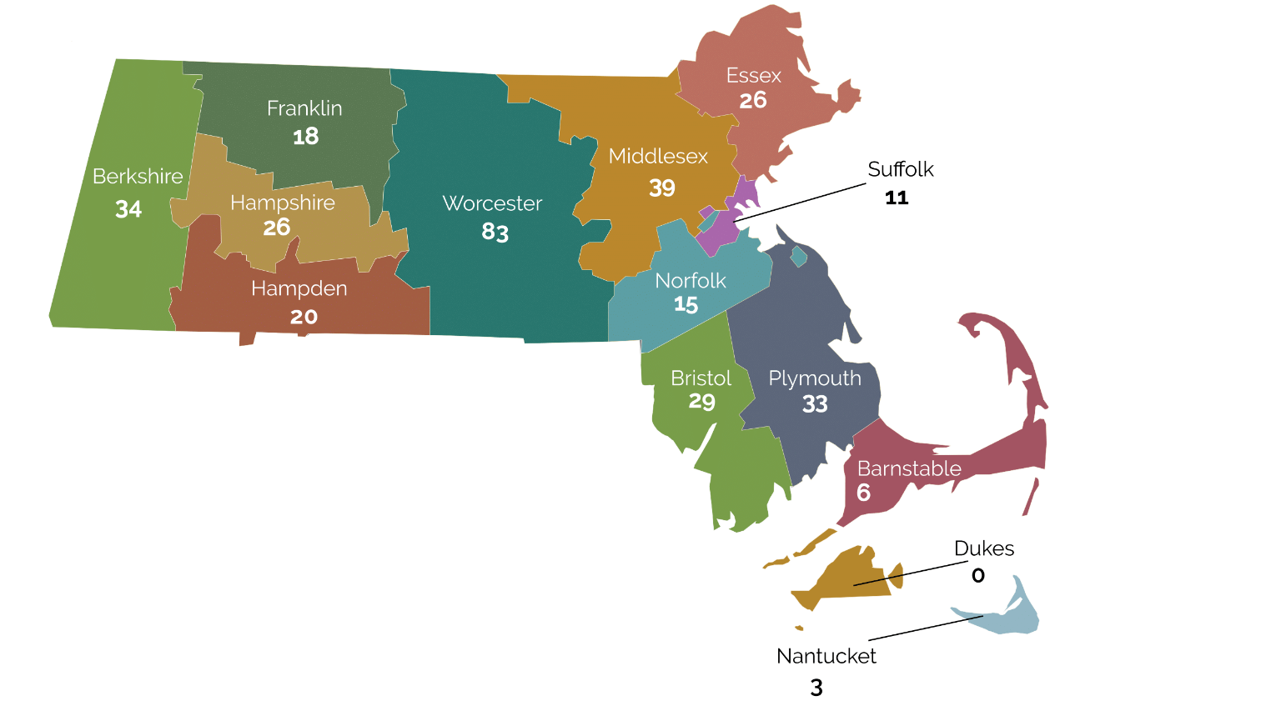
Licensing Applications | April 9, 2020
The totals below are the total number of licenses by county.
COUNTY | # | +/-
BARNSTABLE | 6
BERKSHIRE | 34 | +1
BRISTOL | 29 | +5
DUKES | 0
ESSEX | 26 | +1
FRANKLIN | 18
HAMPDEN | 20 | +2
HAMPSHIRE | 26
MIDDLESEX | 39 | +8
NANTUCKET | 3
NORFOLK | 15 | +1
PLYMOUTH | 33 | +1
SUFFOLK | 11 | +3
WORCESTER | 83 | +12
TOTAL | 343 | +34

Slide 27
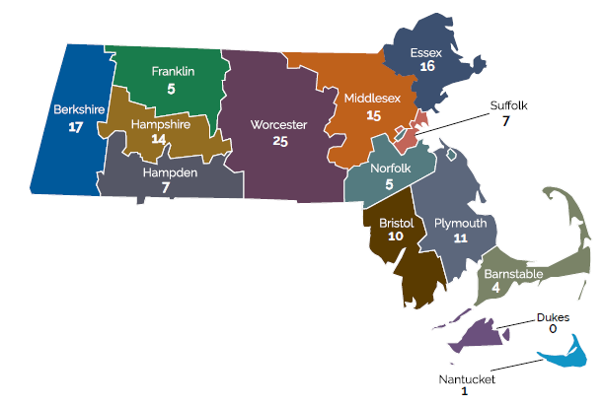
Retail Applications | April 9, 2020
The totals below are the total number of retail licenses by county.
COUNTY | # | +/-
BARNSTABLE | 4
BERKSHIRE | 17
BRISTOL | 10 | +1
DUKES | 0
ESSEX | 16 | +1
FRANKLIN | 5
HAMPDEN | 7
HAMPSHIRE | 14
MIDDLESEX | 15 | +2
NANTUCKET | 1
NORFOLK | 5
PLYMOUTH | 11 | +!
SUFFOLK | 7 | +1
WORCESTER | 25 | +4
TOTAL | 137 | +10

Slide 28
Licensing Applications | April 9, 2020
TYPE | PENDING APPLICATION | INITIAL LICENSE DENIED | PROVISIONALLY APPROVED | PROVISIONAL LICENSE | FINAL LICENSE | COMMENCE OPERATION | TOTAL
Craft Marijuana Cooperative | 2 | 0 | 0 | 1 | 0 | 0 | 3
Independent Testing Laboratory | 5 | 0 | 0 | 1 | 0 | 2 | 8
Marijuana Cultivator | 119 | 2 | 12 | 61 | 5 | 30 | 229
Marijuana Microbusiness | 8 | 0 | 3 | 3 | 1 | 1 | 16
Marijuana Product Manufacturer | 92 | 1 | 11 | 40 | 5 | 26 | 175
Marijuana Research Facility | 4 | 0 | 0 | 0 | 0 | 0 | 4
Marijuana Retailer | 171 | 1 | 16 | 72 | 5 | 44 | 309
Marijuana Transporter with Other Existing ME License | 4 | 0 | 1 | 0 | 0 | 2 | 7
Third Party Transporter | 6 | 0 | 0 | 1 | 0 | 0 | 7
Total | 411 | 4 | 43 | 179 | 16 | 105 | 758

Slide 29
Adult Use Agent Applications | April 9, 2020
  Total Agent Applications:
    124 Pending Establishment Agents
    15 Pending Laboratory Agents
    653 Withdrawn
    1,282 Incomplete
    109 Expired
    2,482 Surrendered
    8,359 Active
Of Total Pending:
  2 not yet reviewed
  124 CCC requested more information
  13 awaiting third party response
  0 Review complete; awaiting approval
139 Total

Slide 30
MMJ Licensing Data | April 9, 2020
MTC License Applications | #
Pending-Application of Intent Stage | 36
Pending-Management and Operations Profile Stage | 10
Pending-Siting Profile Stage | 7
Application Expired | 103
Application Withdrawn | 3
Total | 159
MTC Licenses | #
Provisional | 71
Final | 11
Commence Operations | 61
License Expired | 21
Total | 164

Slide 31
MMJ Agent and Program Data | April 9, 2020
The numbers below are a snapshot of the program for the month of March.
MTC Agent Applications | #
Pending-MTC Agent Applications | 62
Pending-Laboratory Agents | 5
Revoked | 3
Surrendered | 2,820
Expired | 501
Active | 5,739
Total | 9,130
MMJ Program | #
Certified Patients | 69,008
Certified Active Patients | 63,720
Active Caregivers | 6,430
Registered Certifying Physicians | 264
Registered Certifying Nurse Practitioners | 76
Ounces Sold | 51,836

