Slide 1
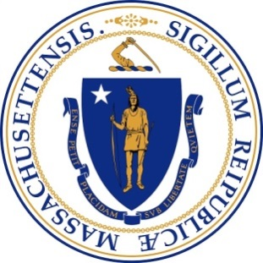
CANNABIS CONTROL COMMISSION
Public Commission Meeting
Tuesday, January 30, 2018
10:30 AM
Mass Gaming Commission
Public Meeting Space
101 Federal Street, 12th Floor
Boston, MA

Slide 2
Cannabis Control Commission
01.30.18 Public Meeting
Agenda
Call to Order
Chairman’s Comments & Updates
Approval of Minutes from Previous Meetings
Approval of Additional Job Descriptions
Commissioner Nominations for the Citizens’ Oversight Committee
Discussion: Possible Locations for Permanent Office Space for the Commission
New Business that the Chairman did not anticipate at time of posting
Next Meeting date

Slide 3
Cannabis Control Commission
01.30.18 Public Meeting
Public Hearings Schedule
Pittsfield – February 5 – 8:30 AM – Berkshire Community Center
Holyoke – February 5 – 2:00 PM – Holyoke Community College
Greenfield – February 6 – 1:00 PM – Franklin Regional Council of Governments
Hyannis – February 6 – 12:00 PM – Barnstable Town Hall
Dartmouth – February 6 – 5:00 PM – UMass School of Law
Worcester – February 7 – 9:00 AM – Worcester Public Library
Danvers – February 7 – 2:00 PM – North Shore Community College
Boston (Downtown) – February 8 – 1:00 PM – McCormack Building
Martha’s Vineyard – February 9 – 10:30 AM – West Tisbury Public Library
Boston (Roxbury) – February 13 – 6:00 PM – Bolling Municipal Building

Slide 4
Cannabis Control Commission
01.30.18 Public Meeting
Agenda
Call to Order
Chairman’s Comments & Updates
Approval of Minutes from Previous Meetings
Approval of Additional Job Descriptions
Commissioner Nominations for the Citizens’ Oversight Committee
Discussion: Possible Locations for Permanent Office Space for the Commission
New Business that the Chairman did not anticipate at time of posting
Next Meeting date

Slide 5
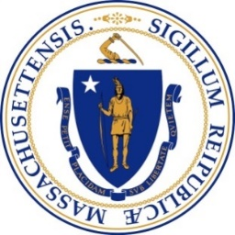
Cannabis Control Commission
Permanent Office Location Options
Criteria/ Options | Downtown Boston | Other Boston (e.g., Roxbury) | Northern Suburbs (e.g., Malden, Somerville) | Southern Suburbs (e.g., Quincy, Braintree) | 128 Belt (e.g., Waltham, Burlington) | 495 Belt/ MetroWest (e.g., Framingham, Westborough) | Worcester
Cost
Availability Full-Service Building Parking (availability and cost)
Accessibility Public Transportation* Other State Agencies
Consistency with Mission Statewide Participation by DHC’s** Model agency
*Public Transportation Guidelines: 1/4-mile radius of an MBTA Rapid Transit Station on specific line (orange, red, silver, or green lines) PREFERENCE vs. REQUIREMENT – named cities/towns
**Participation by DHC’s (Disproportionately Harmed Communities): Yellow indicates that there are DHC’s in this geography
Key:
Green – Positive
Yellow – Neutral
Red - Negative

Slide 6
Cannabis Control Commission
Disproportionately Harmed Communities
Abington
Amherst
Boston (only certain areas to be designated by the Commission)
Braintree
Brockton
Chelsea
Fall River
Fitchburg
Greenfield
Haverhill
Holyoke
Lowell
Lynn
Mansfield
Monson
New Bedford
North Adams
Pittsfield
Quincy
Randolph
Revere
Southbridge
Spencer
Springfield (only certain areas to be designated by the Commission);
Taunton
Walpole
Wareham
West Springfield
Worcester (only certain areas to be designated by the Commission)

Slide 7
Cannabis Control Commission
01.30.18 Public Meeting
Agenda
Call to Order
Chairman’s Comments & Updates
Approval of Minutes from Previous Meetings
Approval of Additional Job Descriptions
Commissioner Nominations for the Citizens’ Oversight Committee
Discussion: Possible Locations for Permanent Office Space for the Commission
New Business that the Chairman did not anticipate at time of posting
Next Meeting date

